Slide 1

Lecture 03 Custom Networking Part 1
Networking Basics
Working with URL
Reference: tutorial-2015/networking/index.html

Slide 2
Why should we study this lecture?
Nowadays, distributed applications are popular. People need large applications, running based on a computer network (local area networks-LANs- or wide area network-WAN), including many sites working concurrently. Do you want to create such applications?
How do we develop Java network applications?

Slide 3
Contents
Networking Basics
Working with URLs

Slide 4
1- Networking Basics
Some definitions related to networking
Client-Server Model

Slide 5
Definitions
Platform: hardware + operating system.
Client: an application running in a computer (such as browser) can receive data from another (server).
Server: an application running in a computer (such as IIS- Windows Internet Information Service) can supply data to others (clients).
IP address (internet protocol): unsigned integer helps identifying a network element(computer, router,…).
IPv4: 4-byte IP address, such as 192.143.5.1
IPv6: 16-byte IP address
Port: unsigned 2-byte integer helps operating system differentiating a network communicating process.
Protocol: Rules for packaging data of a network communication because client and server can be working in different platform. Two common basic protocols are TCP and UDP
Notes:
- Client: Browser
- Bit = 0 & 1
1 byte = 8 bits
4-byte = 8-bit x 4 = 32-bit = 2³² addresses
→16-byte = 8-bit x 16 = 128-bit = 2¹²⁸ addresses
- Rule of Protocol is independently one give, one get

Slide 6
Definitions
TCP: (Transmission Control Protocol) is a connection-based protocol (only one connecting line only) that provides a reliable flow of data between two computers based on the acknowledge mechanism.
UDP: (User Datagram Protocol) is a protocol that sends independent packets of data, called datagrams, from one computer to another with no guarantees about arrival (many connecting lines can be used, acknowledge mechanism is not used). Many firewalls and routers have been configured not to allow UDP packets. Ask your system administrator if UDP is permitted.
Serialization: a process that converts object’s state (values in fields of the object) to a byte stream.
De- serialization: a process that splits data in a byte stream then set data to fields of an object.

Slide 7
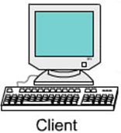
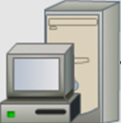
Client-Server Model
Step 2: Server analyzes the request then process it
Step 1: Client sends a request to server
Request can be
(file.html, file.txt
Script file -.asp, .aspx. .php, .jsp….
Execute a method of running object
Response:
File.html, .txt,…
Result of processing
Server
( can be a container, web container or Application container)
Client
(can be a browser)
Step 3: Server sends response to client

Slide 8
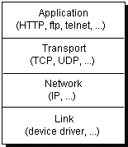
Client-Server Model: Anatomy
Computers running on the Internet communicate to each other:
data
data
Port
H1
data
H1
data
IP
H2
H1
data
H2
H1
data
H3
H2
H1
data
Network
Environment
H3
H2
H1
data
A package is attached an appropriate header (H-identifiable data) when it is transferred to each layer. A layer is an applications or a function library of network managing system

Slide 9
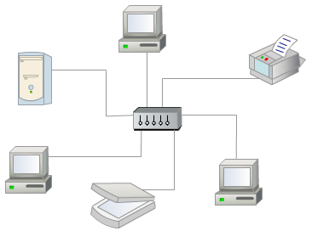
Client-Server Model: Anatomy…
How to distinguish a computer in a network?
IP:152.3.21.121 or Hostname
Personal computer IP: 127.0.0.1
An IP address is either a 32-bit or 128-bit unsigned number used by IP, a lower-level protocol on which protocols like UDP and TCP are built. The IP address architecture is defined by RFC 790:

Slide 10
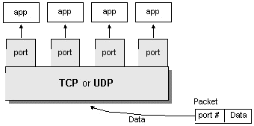
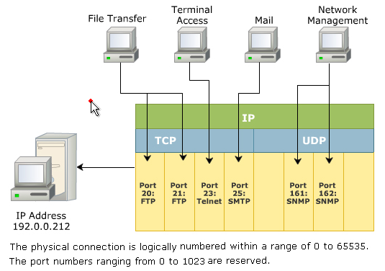
Client-Server Model: Anatomy…
How to distinguish a network-communicating process in a computer?
PORT
Notes:
Distinguish: phân biệt

Slide 11
Client-Server Model: Anatomy…
How to specify a resource in internet/network?
URL: Uniform Resource Locator
URN: Uniform Resource Name. It involves URL and pathname
http://www.abc.com:80/users/index.html
Protocol
://
Host
:
Port
(option)
File
Object name
"rmi://localhost:1098/Math1";

Slide 12
2- Working With URL
The package java.net
The class java.net.URL
Demonstrations for using the URL and URLConnection classes to get contents from urls.

Slide 13
The java.net package
It contains basic APIs for connecting computer networks.
Reference: docs-Java8/api/java/net/package-tree.html
Common used classes:
java.net.URL (implements java.io.Serializable)
java.net.URLConnection ( abstract class)
java.net.HttpURLConnection
java.net.JarURLConnection
java.net.URLDecoder
java.net.URLEncoder
java.net.URLStreamHandler
java.net.ServerSocket (implements java.io.Closeable)
java.net.Socket (implements java.io.Closeable)
This session will introduce the URL only.

Slide 14
The URL Class
A URL takes the form of a string that describes how to find a resource on the Internet. URLs have two main components: the protocol needed to access the resource and the location of the resource.
public final class URL extends Object implements Serializable
Constructors:
URL(String spec) Creates a URL object from the String representation.
URL(String protocol, String host, int port, String file)Creates a URL object from the specified protocol, host, port number, and file.
URL(String protocol, String host, int port, String file, URLStreamHandler handler)Creates a URL object from the specified protocol, host, port number, file, and handler.
URL(String protocol, String host, String file)Creates a URL from the specified protocol name, host name, and file name.
URL(URL context, String spec)Creates a URL by parsing the given spec within a specified context.
URL(URL context, String spec, URLStreamHandler handler)Creates a URL by parsing the given spec with the specified handler within a specified context.

Slide 15
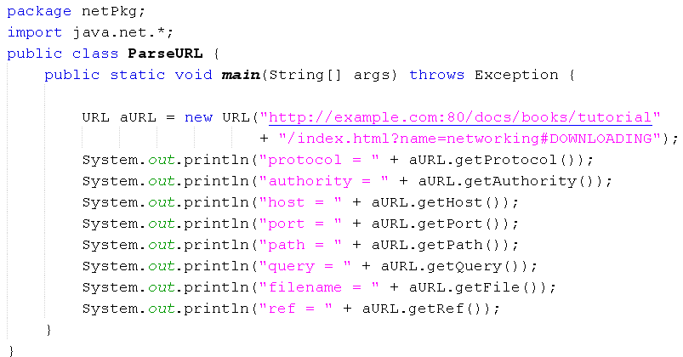
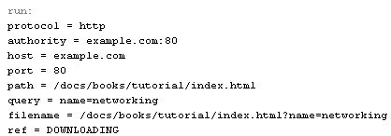
Demo 1: Parse a URL
This program will get components in a URL and no connection is carried out.

Slide 16
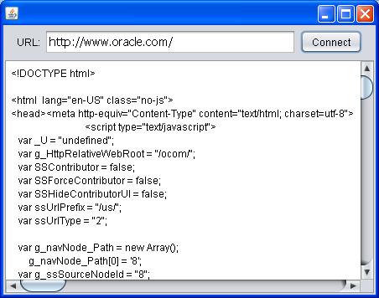
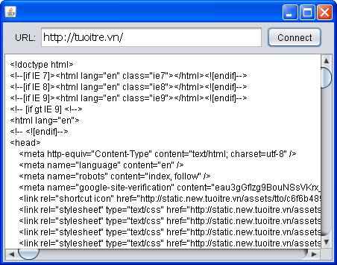
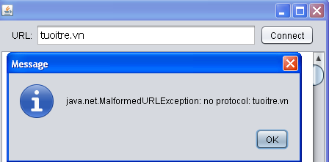
Demo 2: Read a URL
In the following program, if user enters a URL then clicks the button Connect, the content of this URL will be shown. If inputted URL string is malformed, a message will be shown.

Slide 17
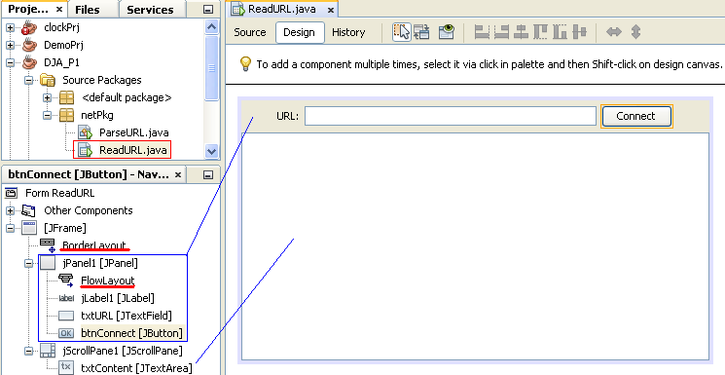

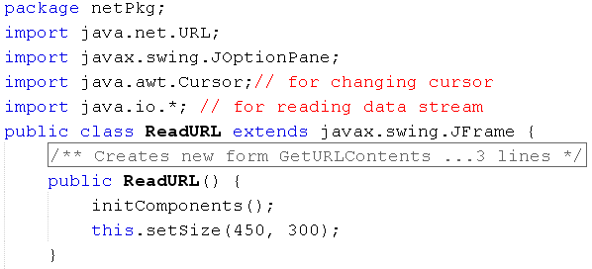
Demo 2: Read a URL…

Slide 18
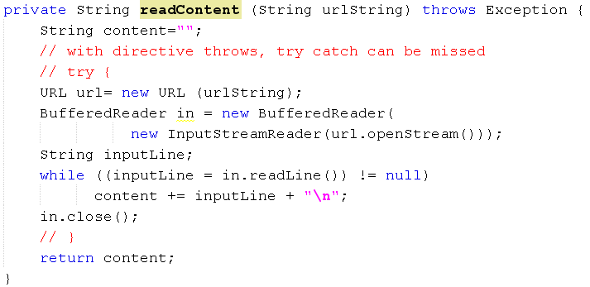
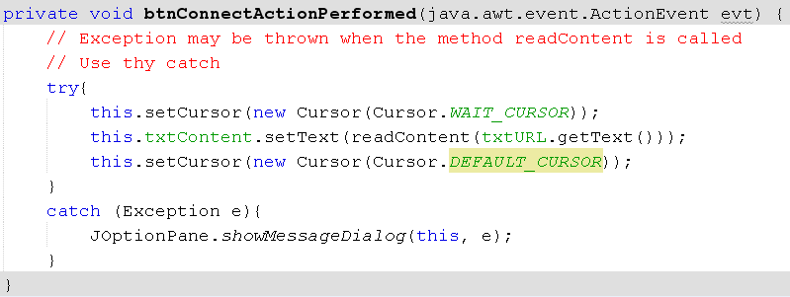
Demo 2: Read a URL…

Slide 19
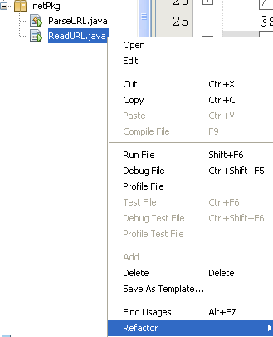
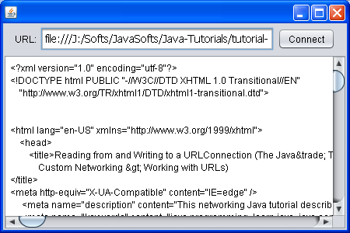
Demo 3: Using URLConnection
Use the function REFRACTOR of NetBeans to copy and rename the class ReadURL to ReadURLConnection, modify code to gain the similar result as following:

Slide 20
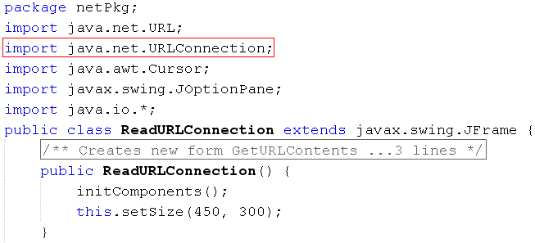
Demo 3: Using URLConnection

Slide 21
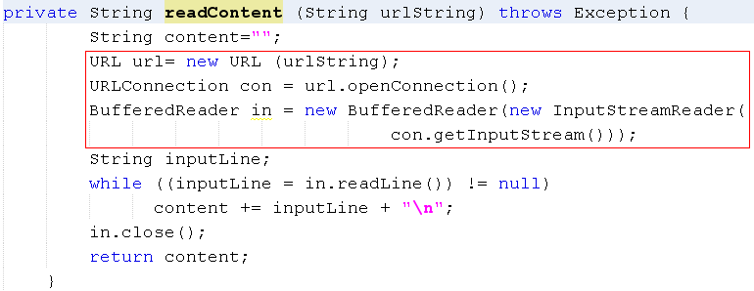
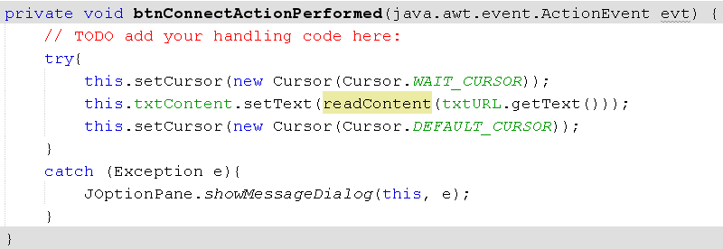
Demo 3: Using URLConnection
This code is modified from those in the previous demo.
This code is not different from those in the previous demo.

Slide 22
Summary
IP and Port
TCP, UDP Protocols
Sockets and Ports
Client Sockets/ Server Sockets in Java
Object Streams and Serialization
Remote Control using Object Streams
Remote Method Invocation
Remote interface, Class for Server object
Server Program, Client Program

Slide 23
Thank You

